Slide 1
Session 11
Bernoulli Scheme
Law of total probability

Slide 2
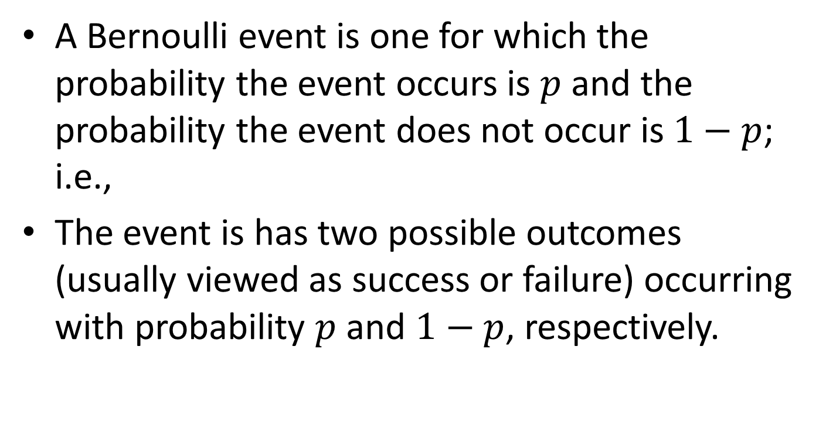
Bernoulli Event
A Bernoulli event is one for which the probability the event occurs is $p$ and the probability the event does not occur is $1−p$; i.e.,
The event is has two possible outcomes (usually viewed as success or failure) occurring with probability $p$ and $1−p$, respectively.

Slide 3
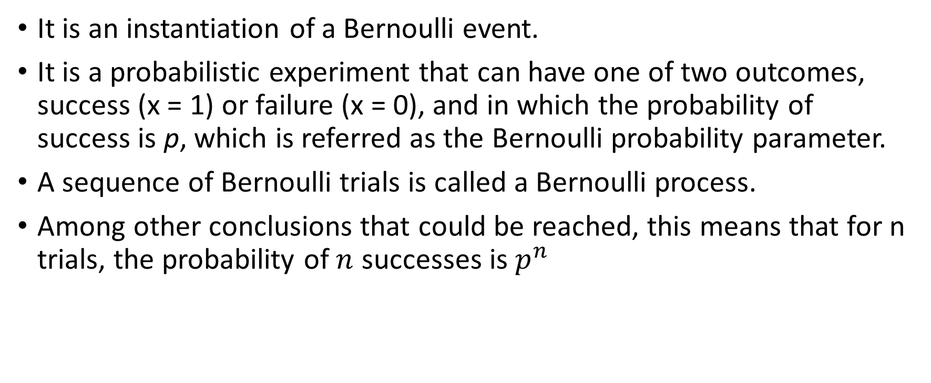
Bernoulli Trial
It is an instantiation of a Bernoulli event.
It is a probabilistic experiment that can have one of two outcomes, success (x = 1) or failure (x = 0), and in which the probability of success is p, which is referred as the Bernoulli probability parameter.
A sequence of Bernoulli trials is called a Bernoulli process.
Among other conclusions that could be reached, this means that for n trials, the probability of $n$ successes is $p^{n}$

Slide 4
Example of Bernoulli Trial
An example of a Bernoulli trial is the inspection of a random item from a production line with the possible result that the item could be acceptable or faulty.
In the dice rolling example, a double six die roll would be your “success” and everything else rolled would be considered a “failure.”

Slide 5
Why Bernoulli Trial
Bernoulli trials are usually phrased in terms of success and failure.
The Bernoulli trial is a basic building block for other discrete distributions such as the binomial, Pascal, geometric, and negative binomial.

Slide 6
Bernoulli Distribution
A Bernoulli distribution is the pair of probabilities of a Bernoulli event, which is too simple to be interesting.
It is implicitly used in “yes-no” decision processes where the choice occurs with the same probability from trial to trial and can be case in the same kind of mathematical notation used to describe more complex distributions.

Slide 7

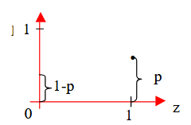
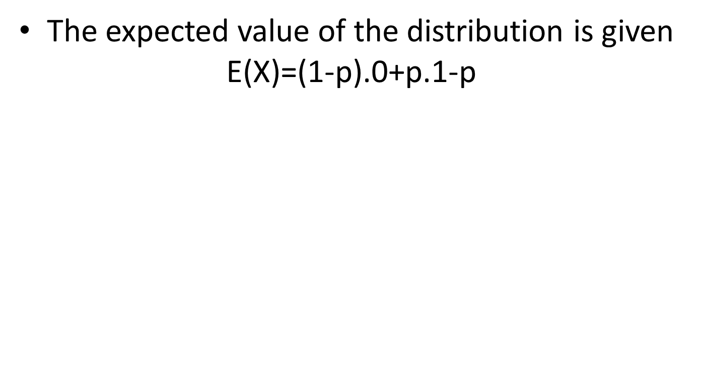

Bernoulli Distribution
The expected value of the distribution is given
$$\text{E}\text{(}\text{X}\text{)=(1−}\text{p}\text{).0+}\text{p}\text{.1−}\text{p}$$
The standard deviation is given by
$$\sqrt{p.(1−p)}$$

Slide 8


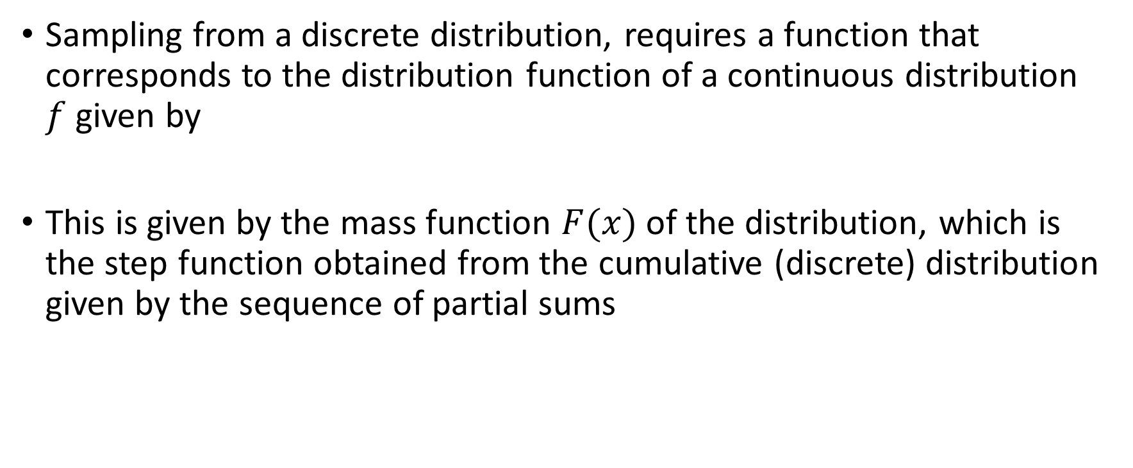
Bernoulli Distribution
Sampling from a discrete distribution, requires a function that corresponds to the distribution function of a continuous distribution $f$ given by
This is given by the mass function $F(x)$ of the distribution, which is the step function obtained from the cumulative (discrete) distribution given by the sequence of partial sums

Slide 9

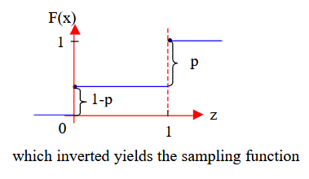
Bernoulli Distribution
For the Bernoulli distribution, F(x) has the construction
which is an increasing function (an so can be inverted in the same manner asfor continuous distributions). Graphically, F(x) looks like

Slide 10
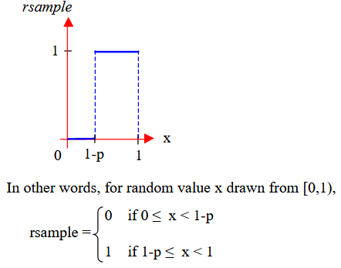
Bernoulli Distribution
Demonstrates that sampling from a discrete distribution, even one as simple as the Bernoulli distribution, can be viewed in the same manner as for continuous distributions

Slide 11
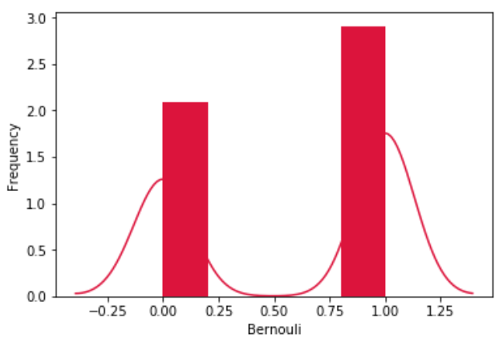
Python Code for Bernoulli Distribution
from scipy.stats import bernoulli
import seaborn as sb
data_bern = bernoulli.rvs(size=1000,p=0.6)
ax = sb.distplot(data_bern, kde=True,
color='crimson',
hist_kws={"linewidth": 25,'alpha':1})
ax.set(xlabel='Bernouli', ylabel='Frequency')

Slide 12
Law of Total Probability
In probability theory, the law (or formula) of total probability is a fundamental rule.
Relating marginal probabilities to conditional probabilities.
It expresses the total probability of an outcome which can be realized via several distinct events

Slide 13
Importance of Law of Total Probability
The total probability rule (also called the Law of Total Probability) breaks up probability calculations into distinct parts.
It is used to find the probability of an event, A, when you don’t know enough about A’s probabilities to calculate it directly.
Instead, you take a related event, B, and use that to calculate the probability for A
The probability for a can be written as sums of event B. The total probability rule is:
P(A) = P(A∩B) + P(A∩B^{c}).

Slide 14
Application of Law of Total Probability
It is used for evaluation of denominator in Bayes’ theorem.

Slide 15
Example
We draw two cards from a deck of shuffled cards with replacement. Find the probability of getting the second card a king.
Let, A – represent the event of getting the first card a king. B – represent the event that the first card is not a king. E – represent the event that the second card is a king.
Then the probability that the second card will be a king or not will be represented by the law of total probability as:

Slide 16
Example(cont.)
P(E)= P(A)P(E|A) + P(B)P(E|B)
Where, P(E) is the probability that second card is a king, P(A) is the probability that the first card is a king, P(E|A) is the probability that the second card is a king given that first card is a king, P(B) is the probability that the first card is not a king, P(E|B) is the probability that the second card is a king but the first card drawn is not a king.
According to question:

Slide 17
Example(cont.)
P(A) = 4 / 52
P(E|A) = 4 / 52
P(B) = 48 / 52
P(E|B) = 4 / 52
Therefore,
P(E) = P(A)P(E|A) + P(B)P(E|B)
=(4 / 52) * (4 / 52) + (48 / 52) * (4 / 52) = 0.0769230

Slide 18
Decision Tree
The decision tree is a simple and convenient method of visualizing problems with the total probability rule.
The decision tree depicts all possible events in a sequence.
Using the decision tree, we can quickly identify the relationships between the events and calculate the conditional probabilities.

Slide 19
Example with Decision Tree
A stock analyst following ABC Corp. He discovered that the company is planning to launch a new project that is likely to affect the company’s stock price. He has identified the following probabilities:
There is a 60% probability of launching a new project.
If a company launches the project, there is a 75% probability that its stock price will increase.
If a company does not launch the project, there is a 30% probability that its stock price will increase.
He wants to find the probability that the company’s stock price will increase. The decision tree for the problem is:

Slide 20
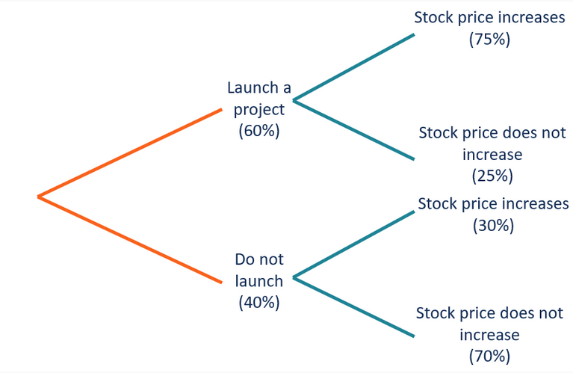
Example with Decision Tree(cont.)

Slide 21
Example with Decision Tree(cont.)
Using the decision tree, we can calculate the following conditional probabilities:
P(Launch a project|Stock price increases) = 0.6 × 0.75 = 0.45
P(Do not launch|Stock price increases) = 0.4 × 0.30 = 0.12
According to the total probability rule, the probability of a stock price increase is:
P(Stock price increases) = P(Launch a project|Stock price increases) + P(Do not launch|Stock price increases)
= 0.45 + 0.12 = 0.57
Thus, there is a 57% probability that the company’s share price will increase.

Slide 22
Law of Probability with Tabular Representation
The idea is the same as the tree, only put the data into a table format.
This is less intuitive than the tree, even though it holds the same information.
This first table holds the information given in the question
Include all of the information, but that leads to complications in the next step (hence, it being less intuitive than the tree).
Next, the rows are multiplied to give joint probabilities:
The total probability rule is the basis for Bayes Theorem.

Slide 23


Example with Tabular Format
80% of people attend their primary care physician regularly; 35% of those people have no health problems crop up during the following year. Out of the 20% of people who don’t see their doctor regularly, only 5% have no health issues during the following year. What is the probability a random person will have no health problems in the following year?

Slide 24

Example with Tabular Format

